Slide 1

Overview: HIV Rapid Test Continuous Quality Improvement (RTCQI)
HIV Serology Diagnostics and Incidence Team
International Laboratory Branch, DGHT
CDC Atlanta
August 26, 2024
HIV RTCQI Best Practice Workshop – Western Hemisphere Region, Panama City
Notes:
Serology team has spearheaded the implementation of RTCQI in collaboration with implementing partners funded through central mechanism. I am pleased to present on an overview of HIV Rapid Test Continuous Quality Improvement (RTCQI) on behalf of the team.

Slide 2
Outline
Context of RTCQI
The concept of RTCQI
Tools for RTCQI implementation
Where we are & the way forward

Slide 3



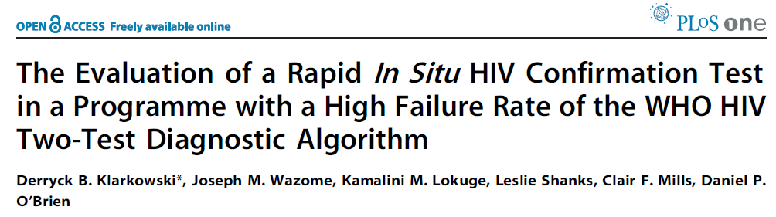
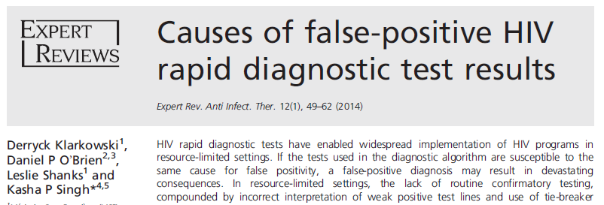



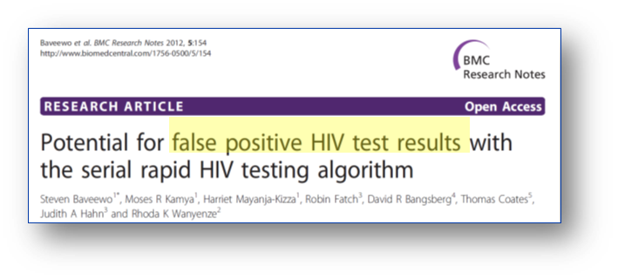
In the era of “Test and Start”
HIV misdiagnosis = unnecessary lifelong antiretroviral treatment
Notes:
Accuracy in HIV diagnostic testing has always been crucial, especially in the era of test and start.
HIV misdiagnosis has been observed and reported over and over by public health scientists on peer-reviewed journals. There were also reports on media regarding lawsuits related to HIV misdiagnosis, including case that made government pay million dollars for a misdiagnosis. Clearly, there is a continuous concern to address on HIV testing quality.

Slide 4
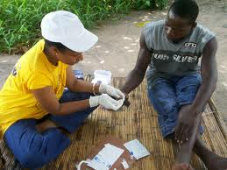
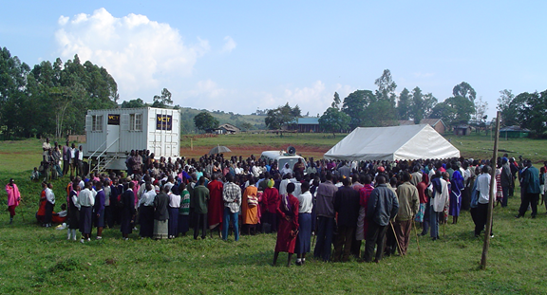
Rapid Expansion of HIV Rapid Diagnostic Tests
Large scale
In FY 2023, 71+ million individuals received HIV testing through PEPFAR*
1% misdiagnosis rate = 710,000 people
Testing in Non-Traditional Settings
* 2023 PEPFAR Global Results and Impact (state.gov)
Notes:
Rapid expansion of HIV rapid tests brought HIV testing to an unprecedented scale. In FY 2023, more than 71 million individuals received HIV testing service through PEPFAR. A 1% misdiagnosis rate means a misdiagnosis of 700+Thousand people.
In effort to bring the HIV testing service closer to where it is most needed, HIV rapid tests are also performed in non-traditional settings through community testing.
Large scale testing and diverse service modality make the call for standardized quality assurance of HIV rapid test evident.

Slide 5
Realities of HIV Testing Under Program Conditions
Poor training and training often done by peers
Testing algorithm and procedures not followed
Disorganized workspace
Run-time not followed, no timers
Safety concerns
Poor finger-prick procedure
PT program inconsistent
Little or no supervision
No corrective actions/feedback
Notes:
Here are a list of the observed HIV RT Quality issues in the field. Including suboptimal training, not following testing algorithm, not following testing procedures, limited PT enrollment/coverage, poor site management, record keeping, lack of corrective actions and so on.

Slide 6
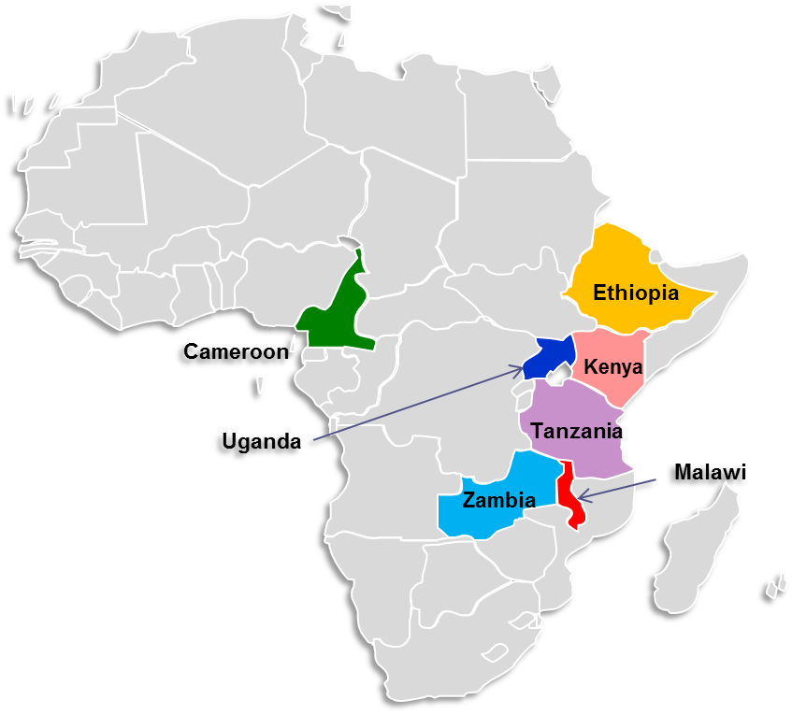
Rapid Testing Continuous Quality Improvement (RT-CQI) Initiative
Launched in 2014 as a proof of concept in 7 focus countries
  Cameroon, Ethiopia, Kenya, Malawi, Tanzania, Uganda, and Zambia
Driven by innovation to achieve better uptake, coverage, and impact
Aim at reducing HIV testing errors to ensure the accuracy of HIV test result delivered to clients.

Slide 7
Five Components/Pillars of RTCQI
Policy Engagement
  Provide a framework for quality testing
  Develop and implement country-specific policy
  Engage stakeholders & advocate for resource allocation
Establishing a Certification Program
  Develop a competency-based training program and certify testers
  Monitor quality compliance and certify testing sites
  Analyze data for gap analysis and corrective actions
Increasing Proficiency Testing
  Increase coverage and participation in PT program (DTS)
  Analyze data for corrective actions

Slide 8
Five Components/Pillars of RTCQI
Scaling up Standardized HTS Register
Lot testing & post market surveillance
Strengthen national capacity to implement verification of new lot & post market surveillance
Increase uptake of standardized HIV testing register
Analyze register data regularly for corrective actions

Slide 9
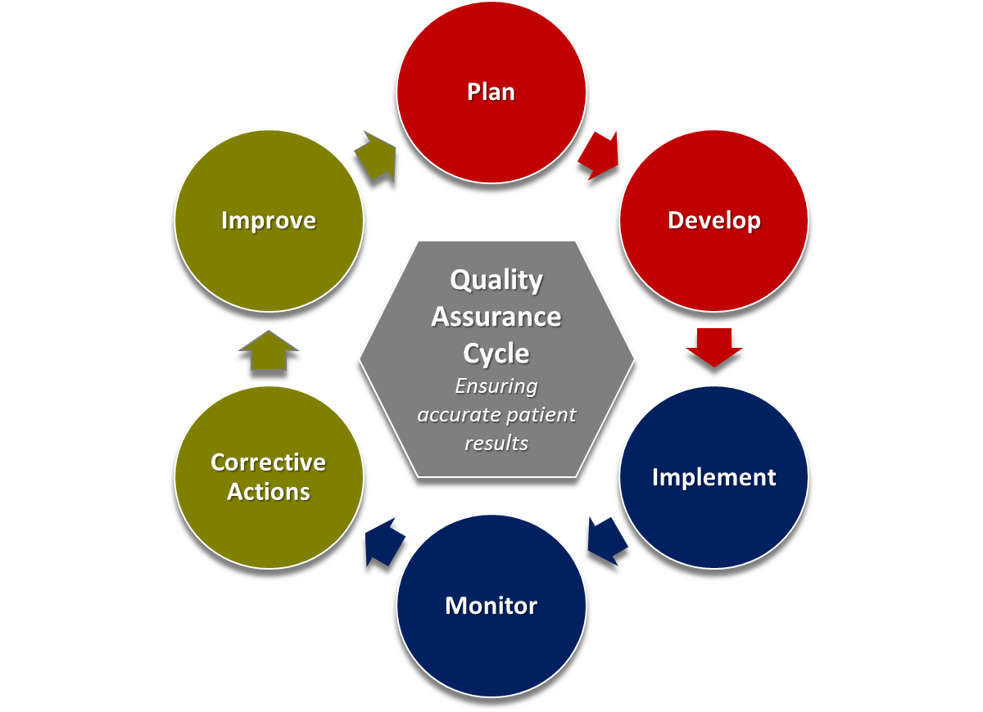
RTCQI Emphasize Quality Assurance Cycle
MOH leadership & ownership
Resource allocation
Country specific plan and objectives
QA mentors
Competency assessors
Site auditors
Site manager & Tester
QA mentors
Competency assessors
Site auditors
Site manager & Tester
Notes:
RTCQI emphasizes quality assurance cycle. And it is a continuous process.
It requires engagement of all stakeholders of QA through the cycle. Requires all-hands on deck.

Slide 10
RTCQI (Initiative) Follows Seven Principals
1. Is intended to be catalytic
2. Establish baseline coverage of QA
3. Improve uptake, coverage & impact of QA
4. Develop country specific targets
5. Emphasize site visits, monitoring & recognition
6. Use Innovative Strategies
7. Emphasize Quality Assurance Cycle (QAC)

Slide 11
Innovative Tool – 1
3 activity-based training packages for capacity building
RTCQI overview – training of QA officers/Q-Corps/QA mentors
SPI-RRT* training – training of auditor for site certification
Tester certification training – training of competency assessor
*SPI-RRT, Stepwise Process for Improving the HIV Rapid and Recency Testing
Notes:
Developed comprehensive training packages for training of QA mentors/officers/Q-Corps, training of competency assessors, training of site auditors.

Slide 12
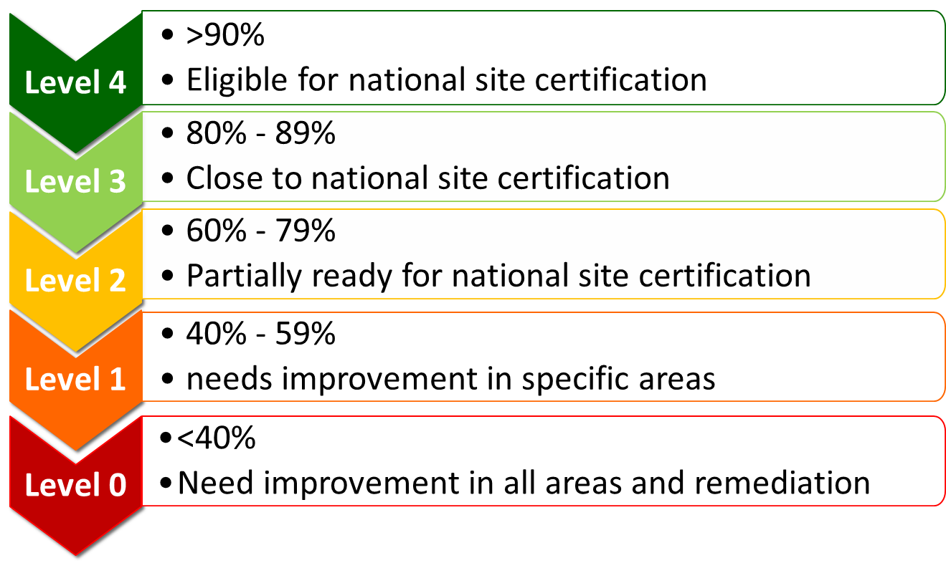
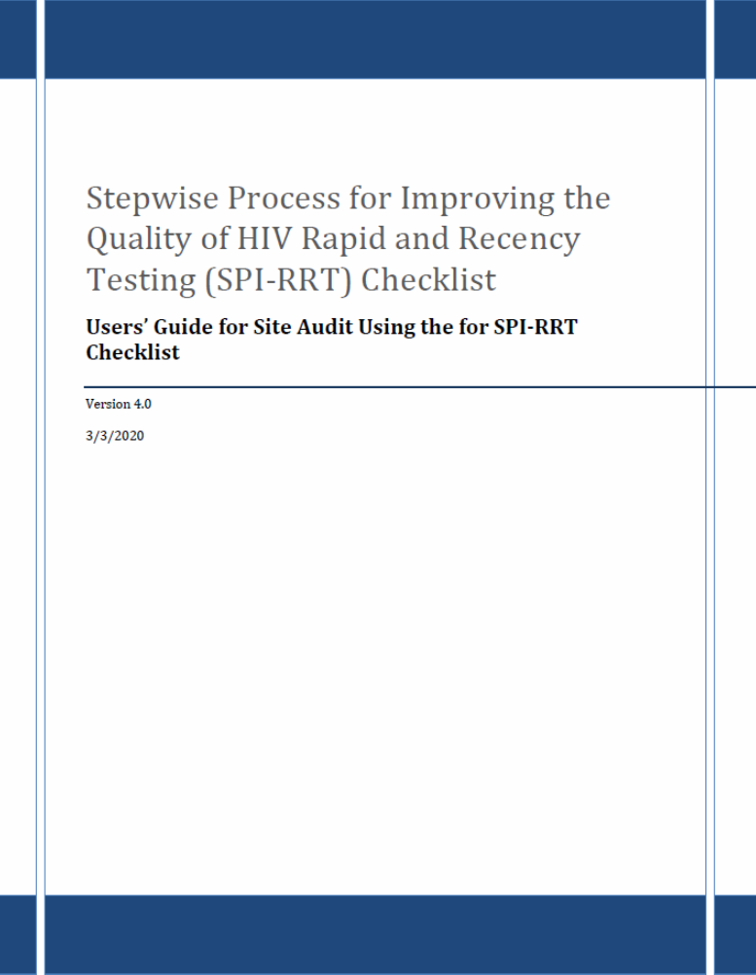
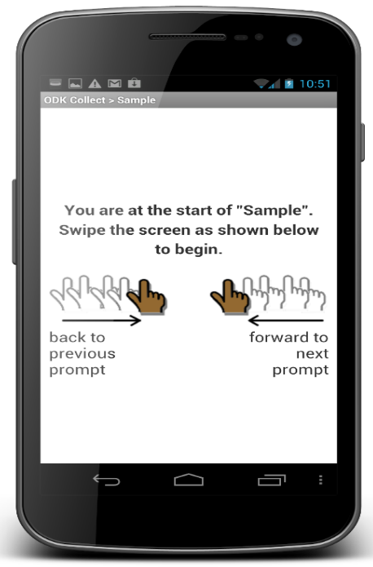
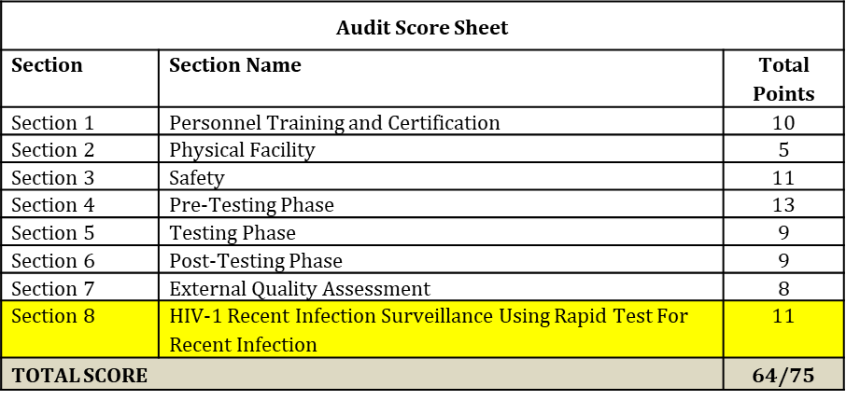
Innovative Tool – 2
SPI-RRT checklist for site monitoring toward certification

Slide 13
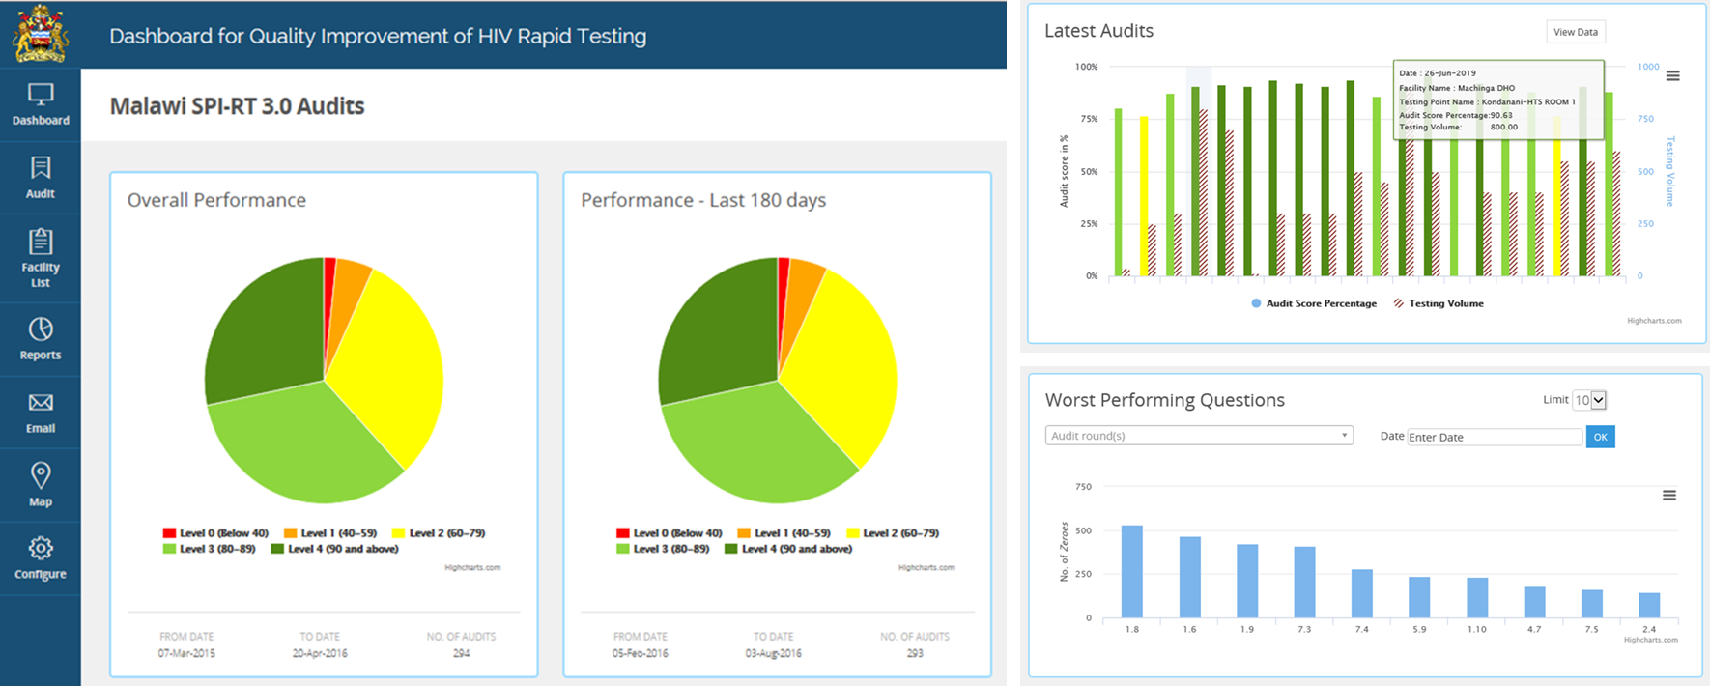
Innovative Tool – 3
SPI-RRT dashboard for site monitoring data visualization

Slide 14
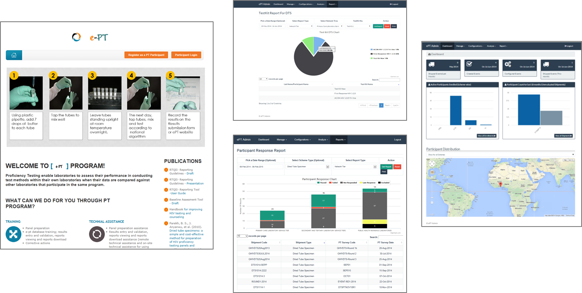
Innovative Tools – 4 & 5
Dried Tube Specimen (DTS) increased PT coverage and uptake
ePT tool for data management and visualization

Slide 15
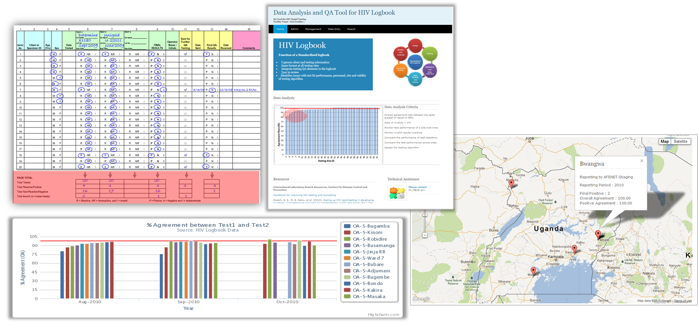
Innovative Tools – 6 & 7
Standardized HTS logbook
eTool for logbook data visualization/use

Slide 16

Implementation of Distance Learning Program
Project ECHO
  Provides accessible and cost-efficient clinical mentorship and continuing professional education
  Fosters the development of peer networks and communities of practice that increase provider satisfaction
  Trains healthcare workers while they remain at their posts, reducing costs related to travel and minimize service disruption
Notes:
We also leverage available distance learning program on RTCQI. Piloted the implementation of ECHO in selected countries.

Slide 17





A Big Stride – From Initiative to Program
Endorsement by MOH to incorporate RT-CQI in National HTS guidelines in +10 countries
Notes:
Since 2014, we have brought the concept of RTCQI to nearly all PEPFAR-supported countries including western hemisphere although implementation level varies across countries. By far, a number of countries has adopted the concept and developed QA national framework. made the big stride from an initiative to program.

Slide 18
Prospects
Continue to advocate for and provide technical support in implementation of RTCQI
Support country-led development of national guidelines for the implementation of RTCQI
Support in-country capacity building
Strengthen the use of data for continuous quality improvement
  Refining existing eTools
  Develop new tools as necessary
Apply the concept/principals of RTCQI to other POC testing for impact
Think innovatively of practical and simpler ways for continuous quality improvement.

Slide 19

Contact your country Implementing Subject Matter Expert (ISME) from Serology Team/ILB
Directly contact
  Ernest Yufenyuy, yod0@cdc.gov
  Xiaojuan Tan, xit0@cdc.gov
  Floris Wray-Gordon, kvf5@cdc.gov
Contact us

